Slide 1
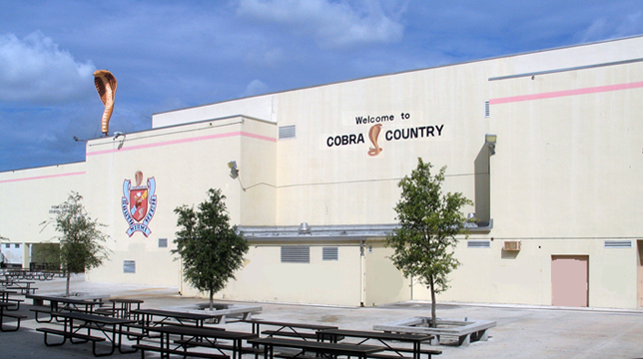
South Miami Senior High
Articulation and Subject Selection
for the 2009-2010 school year
Presented by South Miami Student Services Department

Slide 2
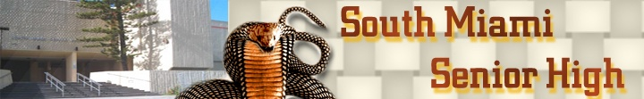
About South Miami Senior High
As the Alma Mater says, the "hope and pride" of South Miami Senior opened its doors to students for the first time on November 10, 1971. The original student body selected the Cobra mascot and the school colors of orange, brown, and white. Today the Cobra mascot reigns from the third story roof of Cobra Hall, greeting all who pass by "Cobra Country" on Miller Road.

Slide 3
About South Miami Senior High
Since opening, South Miami has had five principals: Dr. Warren G. Burchell, Ms. Judy Weiner, Mr. Thomas L. Shaw, Mr. Eugene Butler, Mr. Craig Speziale, and now Mr. Gilberto Bonce. Dr. Burchell has been the longest serving principal in South Miami Senior High history, serving 22 years. Mr. Shaw brought with him a whole new era of curriculum and technological innovation and the school went from one magnet program, to becoming a full-fledged magnet school, the South Miami School of the Arts. Mr. Speziale oversaw the opening of a new building on the South Miami Senior High campus, adding new science labs and art studios. The second building was named Cobra Tower and the original was named Cobra Hall.
Today, Mr. Bonce leads South Miami Senior through the "changes and challenges" mentioned in the school song.

Slide 4
About South Miami Senior High
We are moving in a new and exciting direction to have all students select an academy for their program of study in preparation for their future careers and for developing learning strategies and skills for a successful life.

Slide 5

Administration
Mr. Gilberto Bonce, Principal
Ms. Martha Chang, Assistant Principal
Mr. Pierre Edouard, Assistant Principal
Mrs. Claudia Garcia, Assistant Principal

Slide 6
Student Services Department
Guidance Counselors
  Ms. Maria E. Bergouignan
  Mr. Rodolfo Carbajales
  Ms. Michelle M. Currier
  Ms. Sheryl Pertnoy
  Dr. Maria G. Mendez
  Ms. Maria Moreno
Support Staff
  Ms. Jacqueline Arguelles College (CAP) Advisor
  Ms. Daisy Lester Career Specialist
  Ms. Frances Castaneda Gifted Program Coordinator
  Ms. Zuany Haspil School Social Worker
  Ms. Luz Manchola Student Services Secretary

Slide 7
Graduation Requirements for 2009-2010
High School Graduation Requirements
  24 credits (see State Credit Requirements for Graduation below)
  Pass the Florida Comprehensive Assessment Test (FCAT)
  2.0 cumulative unweighted grade point average (GPA)
  Demonstrate mastery of basic computer literacy skills
  Complete a community service project
State Credit Requirements for Graduation
  English 4
  Mathematics (must include Algebra I and Geometry) 4
  Science (must include Earth/Space Science, Biology, and
  Chemistry OR Physical Science) 3
  Social Studies (World, History, American History, and
  American Government & Economics) 3
  Fine Art (any visual or performing art) 1
  Personal Fitness 0.5
  Physical Education 0.5
  General Electives 8
Note: In order to pass an annual course in grades 9-12, a student must earn a minimum of 10 grade points, of which a minimum of 5 must be earned in the second semester.
Note: Effective with courses completed after September 1, 1998, and thereafter, any student in grades 9-12 or in middle school (grades 6-8) who enrolls in and completes a course designed for senior high school students and receives a grade of D or F as a final grade may repeat that course or one in the same category with a C or better to replace the grade previously earned. Fs will be included in your GPA, if they are not replaced. Fs = 0 points!
For more information consult the Curriculum Bulletin.

Slide 8
The Four Year Academic Plan…
Grade 9 | Grade 10 | Grade 11 | Grade 12
English I (regular, honors, or through ESOL) | English II (regular, honors, or through ESOL) | English III (regular, honors, through ESOL, or AP Language) | English IV (regular, honors, through ESOL, or AP Language)
Algebra I (regular, honors, or BCC for ESOL levels 1 and 2) | Geometry (regular, honors, or BCC for ESOL levels 1 and 2) | Algebra II (regular, honors, or BCC for ESOL levels 1 and 2) | 4th Mathematics (Integrated Math III, Advanced Topics, PreCalculus, Statistics or other higher level mathematics such as AP Calculus)
Earth/Space Science (regular, honors, or BCC for ESOL levels 1 and 2) | Biology (regular, honors, or BCC for ESOL levels 1 and 2) | Chemistry or Physical Science (regular, honors, or BCC for ESOL levels 1 and 2) | 4th Science or other Elective
World History (regular, honors, or AP World History) | Performing or Fine Arts Course | American History (regular, honors, or AP American History) | American Government /Economics (regular, honors, or AP American Government/AP Macroeconomics)
Personal Fitness/ Physical Education | Academy Elective | Academy Elective | Academy Elective
General Elective (for ESOL students includes the ELL class) or Academy Elective | General Elective (for ESOL students includes the ELL class) | General Elective (for ESOL students includes the ELL class) | General Elective (for ESOL students includes the ELL class)

Slide 9
Academies
Architecture and Construction
Culinary Arts
Information Technology
Performing and Visual Arts
Public Service and Security
Communication Arts, Visual Arts and Digital Media

Slide 10
Academy of Architecture and Construction
Drafting/Illustrative Design Technology
Construction Technology
Materials and Processes Technology

Slide 11
Academy of Culinary Arts
Culinary Operations

Slide 12
Academy of
Information Technology
Digital Design Technology
Network Systems: CISCO, Microsoft, UNIX, LINUX
Web Design Technology

Slide 13
Academy of Performing and Visual Arts
Art
Dance
Drama
Music

Slide 14
Academy of
Public Service and Security
JROTC

Slide 15

Magnet Academy of
Communication Arts,
Visual Arts and Digital Media
Digital Photography
Drawing and Painting
Television Production
Music

Slide 16
Sports
Fall Sports Teams
  Football
  Cross Country
  Girls Volleyball
  Golf
  Swimming
Winter Sports Teams
  Soccer
  Basketball
  Wrestling
Spring Sports Team
  Baseball
  Softball
  Badminton
  Track and Field
  Tennis
  Boys Volleyball

Slide 17
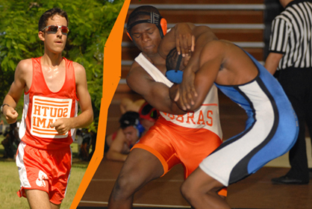
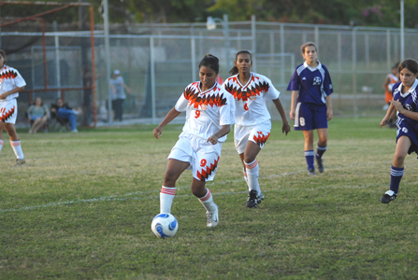
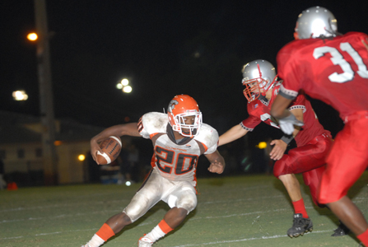
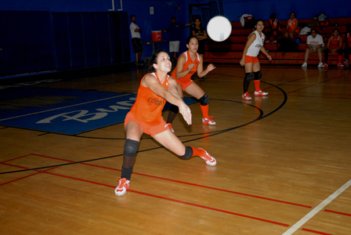
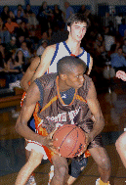
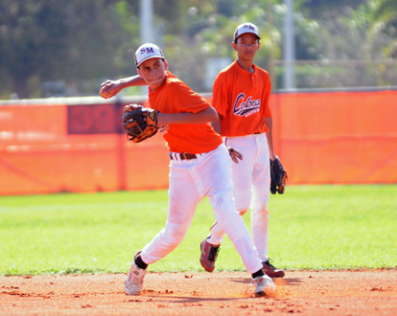
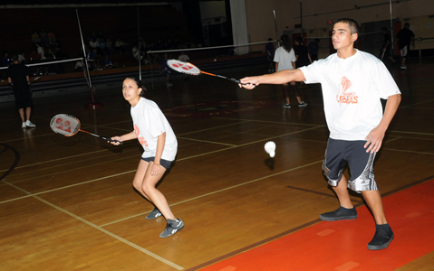
Sports

Slide 18
Athletics Department
Paula Raflowitz Athletics Director
Danny Lavandeira Assistant Athletics Director
James Colzie Business Manager
Mary Medina Athletic Trainer
Marylin Bouzon Assistant Athletic Trainer
Athletics Office Telephone
305-666-5871 ex 2339
Fax Number
786-268-1881

Slide 19
Clubs
5000 Role Models
Abstinence 'Wait' Club
Best Buddies Club
Bible Club
Cafe Cobra
CECF (Career Education Clubs of Florida)
Cheerleaders (Varsity) JV
Class of 2009
Class of 2010
Class of 2011
Class of 2012
Cobra Charmers
Cobra Readers
Drama Club
Engineering Club
English Honor Society
Environmental Society

Slide 20
Clubs
FBLA (Future Business Leaders of America)
FCCLA (Family, Career,and Community Leaders of America)
FEA (Future Educators of America)
French Club/French Honor Society
Inter Club Council
Italian Club
Interact Club
JROTC - Color Guard
JROTC- Raiders
Key Club
Mu Alpha Theta Society (Math Honor)
National Honor Society
New Americans Club

Slide 21
Clubs
SADD
Science Honor Society
Silver Knights
Social Studies Honor Society
Spanish Spirit/Spanish Honor Society
Sports Medicine
Student Government
Video Club

Slide 22
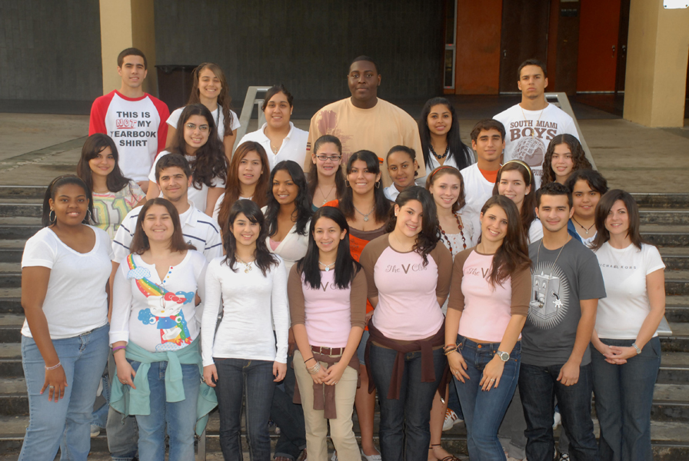
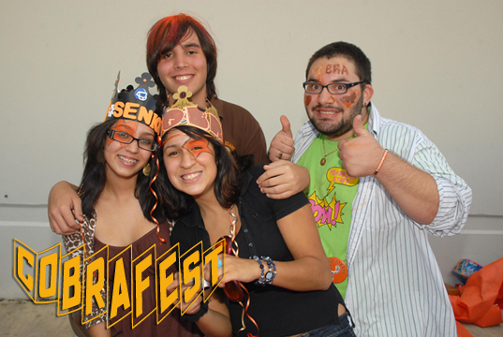
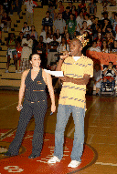
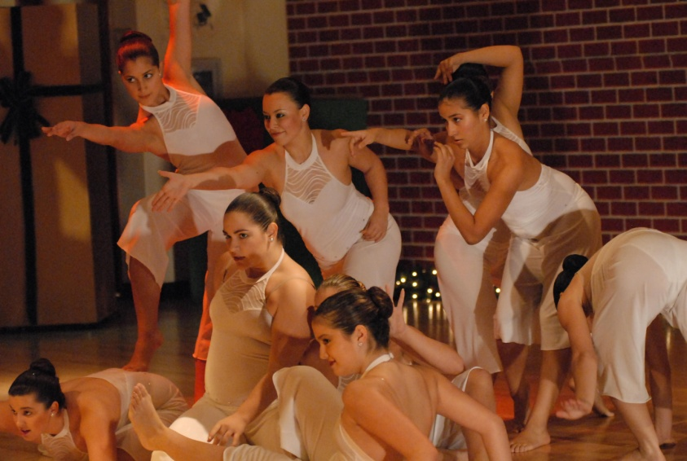
Activities

